Slide 1

Carbon-ML
CARBON REPORTING MARKUP LANGUAGE
...like barcodes for product CO2e declarations

Slide 2


Carbon-ML About Us
The Carbon-ML project is developing an open-source ecosystem to provide declarations of measurements for embodied carbon in any product or service.
Carbon-ML is incubated by Carbon Finance Labs in partnership with Oxy Low Carbon Ventures with a goal to evolve into an independently governed project.
A finance and technology incubator creating climate change solutions. Our impact comes from a global network of resources and knowledge built over decades spent in the carbon, finance and technology sectors.
Oxy Low Carbon Ventures, LLC (OLCV), a subsidiary of Occidental, Petroleum

Slide 3
The Problem: Measuring, Reporting, Tracking Embodied Carbon in Products is a mess.
Numerous measurements, policies, mandates, systems, etc. all designed to measure carbon emissions – but lack consistency between them
Carbon focus today is mainly at the Company, not the individual Product level
Currently, carbon embodied in making products remains hidden across supply chains

Slide 4
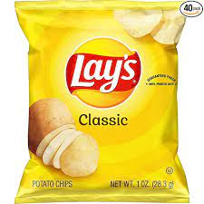
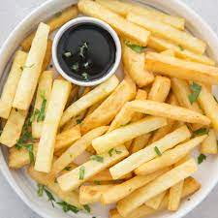


Problem: embodied CO2e Data = No Context
What you said:
“<Chips> have 20g of CO2e/Kg”
Manufacturer
Distributor
Customs Agent
Retailer
Telephone game problem:
Message intent & context is lost at each hand-off
What they heard:
“<Chips> have 20g of CO2e/Kg.”
Which chips?
How Calculated?
How verified?
Who said that?
When was it said?
<Chips?>

Slide 5
Today Context gets re-mapped at each handoff: structured data w/context could help
Manufacturer
Distributor
Customs Agent
Retailer
<Key, Value> pair can provide context for what is being tagged
<Foodchips,potato5667>
<Producer,Frito Lay>
<CO2e/KG,20 g>
<LCA Method,Cradle:gate 5074>
<Verified by,Auditco llc>
<….,….>

Slide 6

The Vision
Carbon data flowing between all product related system interactions while maintaining context.
Solution: an open-source global ecosystem:
An extensible schema using existing product taxonomies, enabling trusted and visible declarations of embodied carbon in every product at all points & actors across supply chains.

Slide 7
The Goal:
Make Embodied Carbon Data Sharing Easy
An evolving ecosystem using an extensible schema to reference existing product taxonomies to declare measured embodied carbon (CO2e) that is trusted and visible, open-source, adaptable for easy implementation, and technology agnostic.
Empowered private and public sector actors producing and/or consuming trackable declarations of the embodied carbon for any product across supply chains.
Embodied carbon information shown on product labels so that companies, consumers, suppliers, governments, etc. make better choices.

Slide 8
The Outcomes
Major Actor changes:
Products & Economic impact:
New behaviors:
Corporate purchasing
Customer pressure
Government policy
New goods & services
Growth in voluntary carbon market
Better Understanding of embodied carbon
Conversations & trust
New Choices made

Slide 9

Carbon-ML Guiding Principles
Carbon-ML combines declaring, measuring, tracking and tracing embodied carbon within any product with the development of an ecosystem using
an extensible schema and
underlying related taxonomies
open-source technical code;
Using principles from climate, product, sustainability, and technology taxonomies.
A primary principle is ecosystem adaptability for local, regional, and country based norms.
And, for the evolving ecosystem’s schema and taxonomies, as related ecosystems, products, supply chains evolve. Basically tracking and tracing embodied carbon at each branching point….for each tree as each branch changes.
Other principles include non-proprietary (technology agnostic), language commonality, active collaboration with corporate / govts, standardized measure and metric use, and open and robust governance.

Slide 10
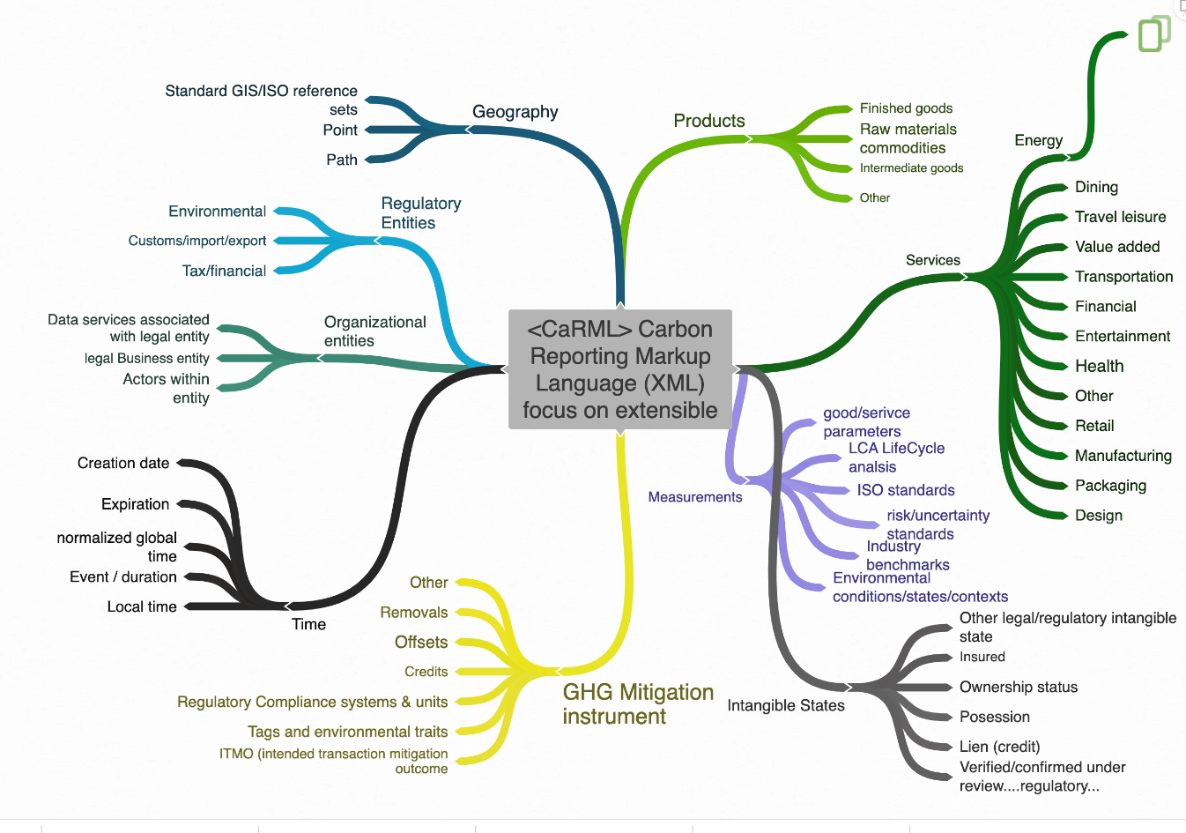
Carbon-ML <CarML>
Ecosystem: Schema & Taxonomies

Slide 11
Schema = intelligent context
Re-use data from other systems leading to faster integrations
Repurpose existing schemas and data contexts
Data retains value/context and is exchangeable between systems
CO2e Data objects with context are shared and utilized to automat forms submissions & reporting
Continual machine learning about changes in CO2e flows with contextual inference

Slide 12

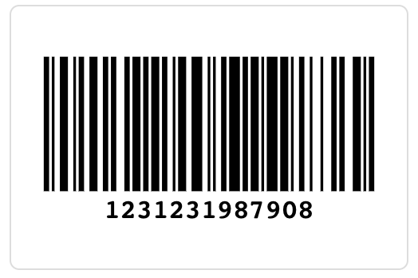
Context = tag & taxonomy
<context,specific> what we are “talking” about.
XML TAG (eXtensible Markup Language)
Machine readible <Key, Value> pair associated with an attribute.
<GS1_food, twix_candy_bar123123987908>
Taxonomy (structure, context)
Meta data tags to define things
Approved / recognized formally or informally. example GS1* =100m FMCG barcodes
Provides external context for “what” is being tagged.
<GS1_food, xxxx>, <GS1_soap, xxxx>, <GS1_beer, xxxx>
Product GS1 schema =
100m FMCG
*GS1 is non-profit industry group maintaining product codes for 100 million FMCG (fast moving consumer goods)

Slide 13
What is Carbon Reporting Markup Language <CarML>
CarML enables shared context for reporting embodied carbon data objects.
CarML is open-source XML: standard for how product / service information about CO2e is created, processed, distributed, declared and shared.
Useful for many product / service handoffs
<CarML> creates interactive / intelligent CO2e data
Essentially a “Bar Code” for Embodied Carbon information for products/services
 | Business | Government | Machine | Consumer | Other
Business | B to B | B to G | B to M | B to C | B to Other
Government | G to B | G to G | G to M | G to C | G to Other
Machine | M to B | M to G | M to M | M to C | M to Other
Consumer | C to B | C to G | C to M | C to C | C to Other
Other | Other to B | Other to G | Other to M | Other to C | Other to Other

Slide 14
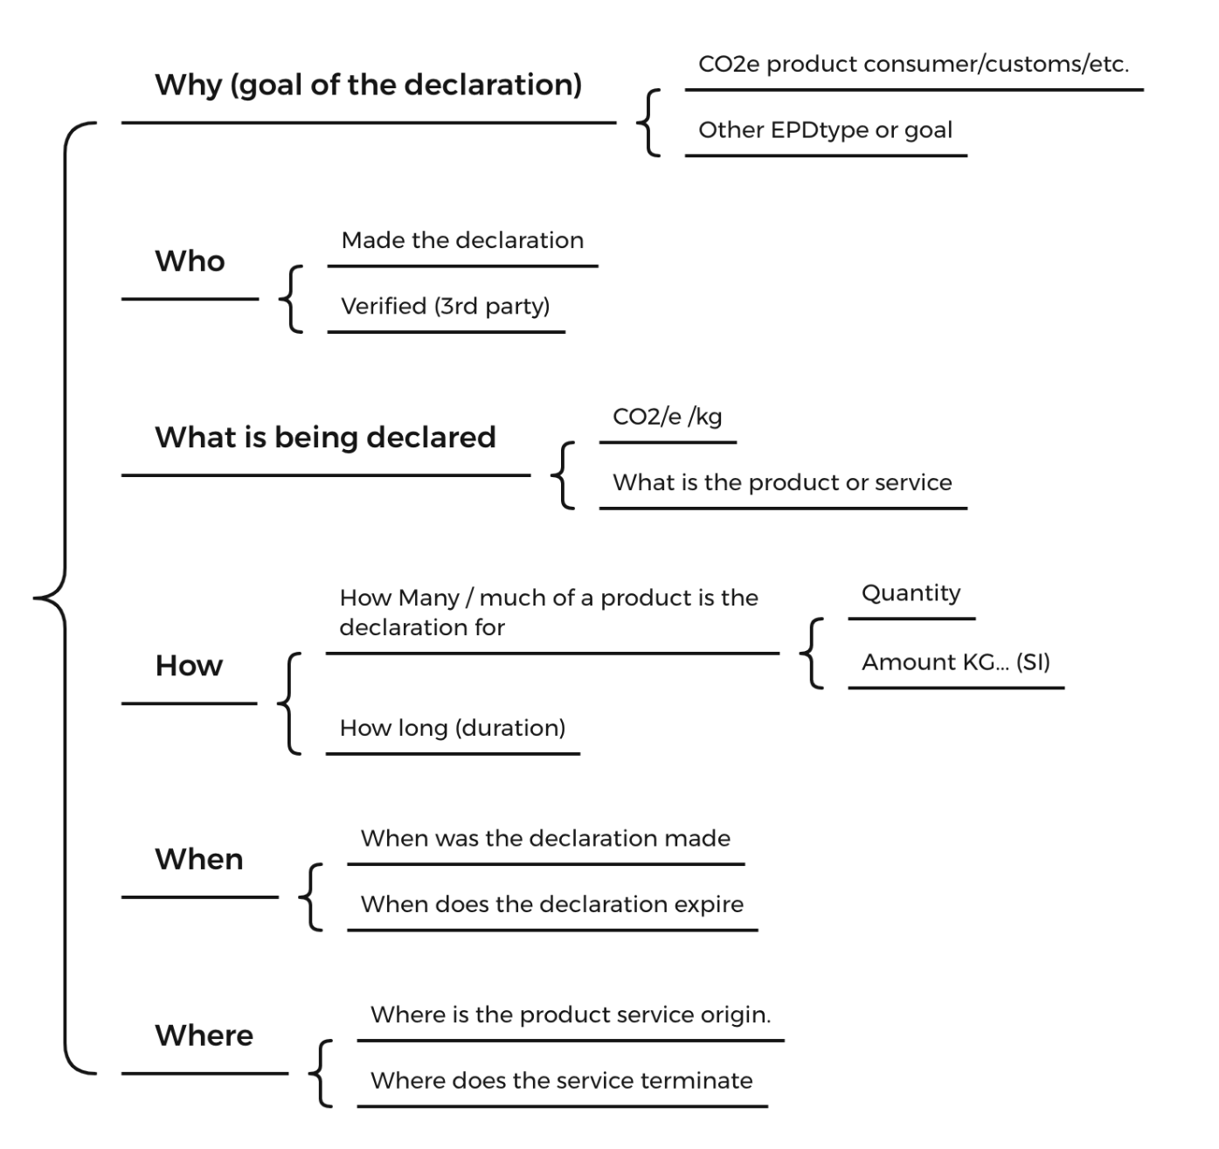
Carbon-ML Ecosystem: Root Schema points to/uses Unique Taxonomies

Slide 15
Carbon-ML Ecosystem -
Why declaration or state is made/updated
Why the event (change in CO2e) happened (process description)
Why carbon was added / altered
Why a good or service was updated or changed
Can include non-carbon add events:
Legal state changes/assignments
Logical changes/assignements
Examples: Duty paid, package certified, audit completed, auditor verified etc.

Slide 16
Carbon-ML Ecosystem - Who
(entity said / did a thing)
Declaring Carbon Related Fact(s)
Ecosystem Roles
Corporations
Commodity producers
Governments
Regulators
NGO’s IGO
Researchers
Verifiers such as auditors
Owners of a product or service
Consumer of a product or service
Procurement agents
Carbon registrar or issuer
Verifier or reviewer (entity)
Product innovators
Individual viewer or observer

Slide 17
Carbon-ML Ecosystem - What
impacts a CO2e declaration
What products and services are being referenced, identification schema may include:
ISO Codes
GS1 (barcodes)
SIC or standard descriptors of service definitions
LCA references
What type of activity or process is being conducted
What is the CO2e impact on the goods or services

Slide 18



Carbon-ML Ecosystem - How
was this fact about CO2e assessed / derived
MAY INCLUDE ASSIGNMENT OF OFFSETS/Removal instruments TO PRODUCTS
HOW DID A CARBON FACTOR CHANGE
WHAT WAS THE CO2e AMOUNT & LCA TYPE METHODOLOGY USED

Slide 19



Carbon-ML Ecosystem -
When a CO2e fact occurs or is declared
Point in Time event: ISO standard time convention
Relative elapsed time:
Examples:
Relative to the location where something occurred,
As an absolute reference to an event.
Process start, end, completion
Product event
Time of system and data entry update
Service initiation, completion
Product or process expiration
Credit remediation expiration

Slide 20



Carbon-ML Ecosystem -
Where did the activity occur
Point or Service Route
A point along the supply chain
GIS/ISO standards for maps / geo locations

Slide 21
<CarML>
Examples and Use Cases

Slide 22
Barcodes for product CO2e declarations
Manufacturer
Distributor
Customs Agent
Retailer
<CaRML> reference XSD w/ schema/Taxonomy pointers
Product GS1
100m FMCG
What we are talking about.
Xml.1.0 <carml 0.1>
Key,Value
<Product GS1>,<12312319879087>
<LCA method>,<CandyBar>
<Corporate entity>,<12312Mars.inc>
<CO2e/ kg >,<540g/kg>
LCA data taxonomy
How we measured CO2e.
Reuters entity library
Who declared /verified etc.

Slide 23
XML = Open Extensible Schema: any taxonomy
<taxonomy> What we are talking about.
Manufacturer
Distributor
Customs Agent
Retailer
Widget
<CaRML> reference XSD w/ Taxonomy pointers
Product Any widget industry taxonomy
Widgets=Steel, chemicals, travel hydrogen, cheese……
Xml.1.0 <carml0.1>
Key,Value
<Product Any>,<widget9087>
<LCA method>,<widget>
<Corporate entity>,<12312Acme.inc>
<CO2e/ kg >,<540g/kg>
LCA data base
How we measured CO2e.
Reuters entity library
Who declared /verified etc.

Slide 24
Declared/Shared CO2e content needs Context(s) <Root_Schema,Taxonomy,Key,Value>
Root declaration | Schema(s) context | Key | Value data
What we are talking about | <GS1_FMCG_database>, <Fuels_industry_schema>, <plastics_industry>,<Metals_association> | <GS1_Food_item> | <Twix_bar_1023>
Who made the declaration, verification, attestation | <Reuters_entity>,<govt_XYX_lookup>, <insert_favorite> | <UK entity> | <Mars co. 502934>
How was CO2e measured LCA, LCI method | <Open_LCA>,<EU_regulatory_LCI>, <new_schama_metric_tool> | <food 10244 method> | <Cradle 2 gate>
How much CO2e was reports | <CaRML>,<other_reporting_EPC>, <ISO_schema> | <CO2e KG> | <0.015>
When did this occur | <ISO_Time_conventions> | <GMT> | <15:02:32>
Where did this occur | <ISO_GPS_location_convention> | <long,Lat> | <34.092,-118.328>
???? | <Extensible_open_schema>

Slide 25
Carbon-ML Use Cases
FMCG Labeling with GS1
International Trade / Customs & Border Agents
Materials / Supplies Purchasing Decisions
Financial Markets / Investment Decisions
Government and State Regulators
Carbon-ML supporting GS1 would allow for the “labelling” of approximately 100 million consumer products out of the box and be integrated w/ many inventory/supply chain systems.
Carbon-ML supporting international trade/customs and border agents, policies such as the EU Carbon Border Adjustment Mechanism (CBAM)
Carbon-ML supporting measurement & labeling of embodied carbon within a product or service at every point along the supply chain
Carbon-ML supporting financial markets investment decision making by providing more accurate tracing and tracking, and comparable representations of embodied carbon within products and services by companies.
Carbon-ML supporting Government and State regulators understanding of carbon related data, standardized data allows for better comparability and tracking of embodied carbon within products and services.
Processing managers can compare based on Carbon quality
Consumers can make more informed decisions
More accurate and standardized assessment of reporting of embodied carbon in products in line with customs carbon border policies
Purchasing managers can make more informed procurement decisions
Goods and services can be compared based on embodied carbon
Asset managers can make more informed decisions relating to portfolio carbon footprint
Shareholders have greater understanding of corporate impact profile
Better assessment of procurement processes and service provider selections
Better assessment of legislation, regulations, and enforcement

Slide 26
Get Involved!
To learn more about the Carbon-ML project, contact us at info@carbon-ml.org, and share:
Your interest:
Participate as Industry advisor
Participate from standards/taxonomy organization
Participate providing governance oversight
Participate providing technology expertise
Mailing list only
If you would like to participate, how would you like to contribute to Carbon-ML, what areas of expertise do you have, have you worked on a standards or taxonomy project before
What carbon data problem you would like to see solved

Slide 27
Carbon-ML Core Team
Nick.Gogerty@carbonfinancelab.com
Jonathan.Hollander@carbonfinancelab.com
Lynn.Connolly@carbon-ml.org
info@carbon-ml.org
www.carbon-ml.org

Slide 28
Thank you!

Slide 29
Carbon-ML <CarML> Schema & Ecosystem Summary
<CarML>: An open extensible markup language supporting a collection of new or ideally existing schema to ease structured machine communications and declarations about the carbon CO2e associated with all economic activities at the individual product and/or service level.
The <CarML> extensible schema evolves by using existing product taxonomies, not being fully proscriptive of any one solution or interpretation.
<CarML> is transparent providing machine readable CO2e data. This accelerates reporting across supply chains, creating awareness of carbon and enables efforts to reduce CO2e to create new higher valued products and services.
There is no <CarML> schema terminal solution. <CarML> is extensible and designed for usability and extension such that only part of the tool or tags needs implemention to get benefits.
Early <CarML> schemas will be shaped from key industry and policy stakeholders building on schemas and taxonomies in use by other industries and software solutions.
Non-proprietary. No one should own a language.

